Slide 1

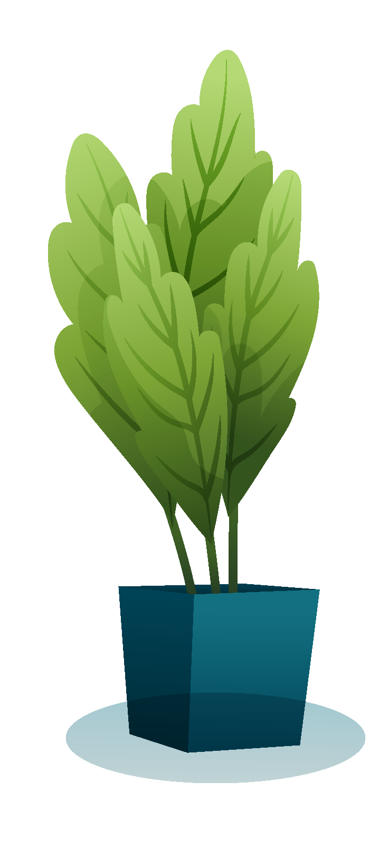
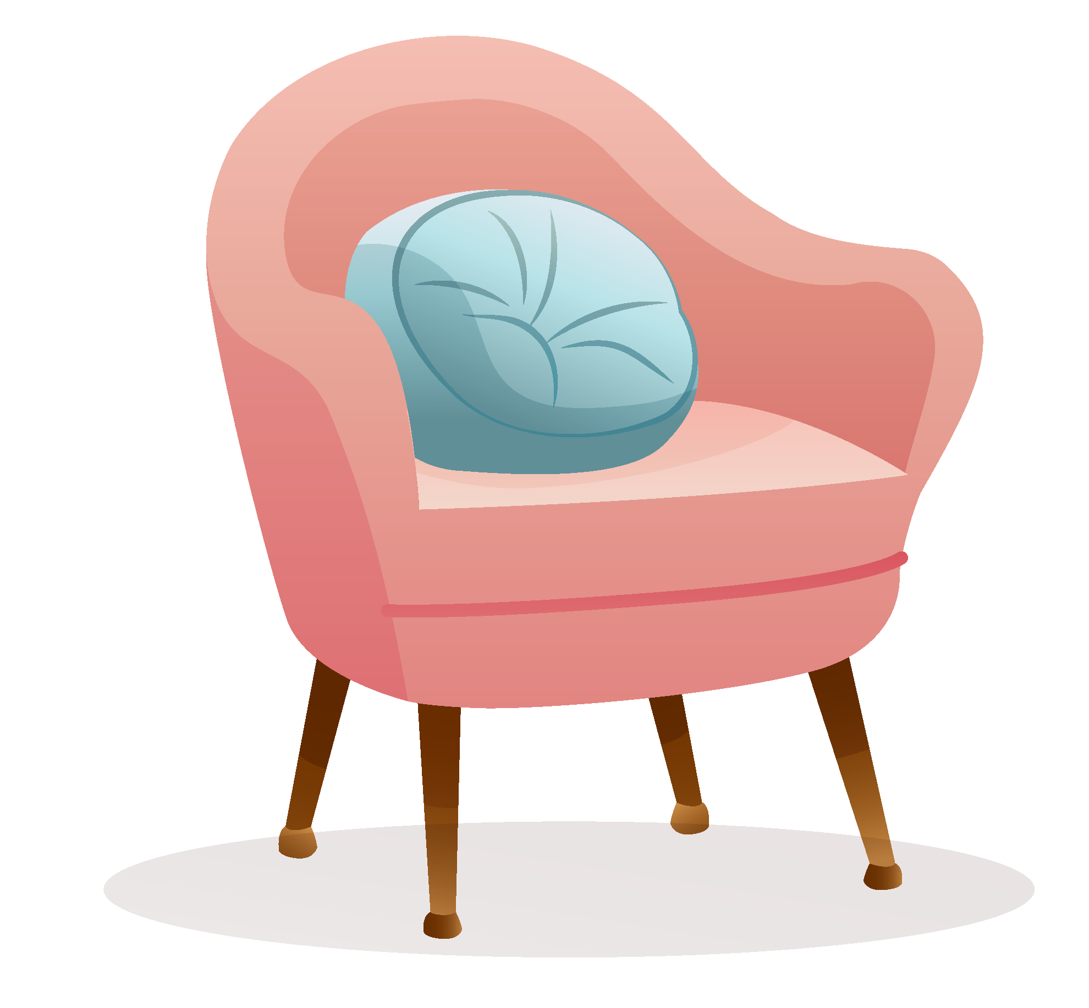

¿CÓMO ES TU CASA?
Grado 7°

Slide 2
Los objetivos
Al terminar esta lección, las estudiantes podrán
Describe | Describe their houses appropriately
Use | Use the adverbs in sentences correctly
Conjugate | Conjugate the verbs SER and TENER correctly according to the subject of each sentence.
Colors | Identify at least 12 Spanish colors.
Use | Use the colours in sentences

Slide 3


BRAINSTORM
What verb do you think we will be using?
Do you know any adjectives that can be used to describe a house?
Notes:
Teachers will also ask students to identify the word for house, and the gender of the word.

Slide 4
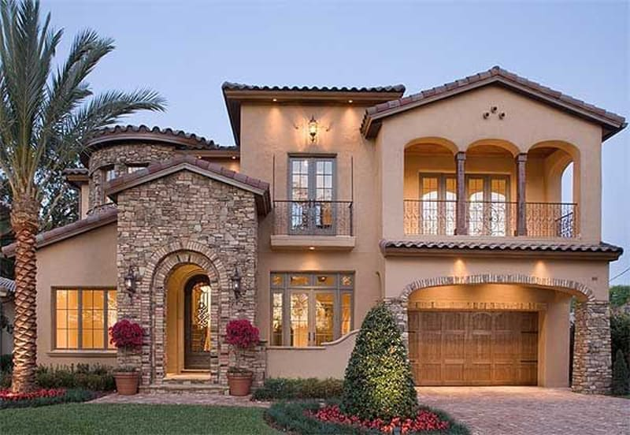
When you look at this picture, what are some adjectives that come to mind to describe a house?

Slide 5
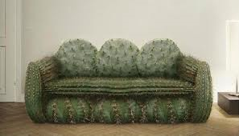
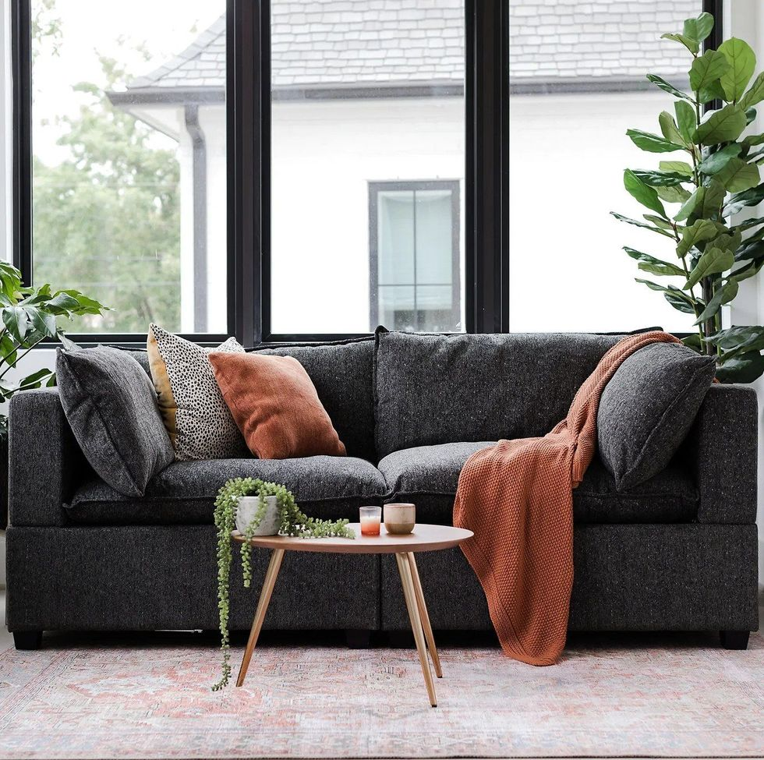
CÓMODO/A
comfortable
INCÓMODO/A
uncomfortable

Slide 6
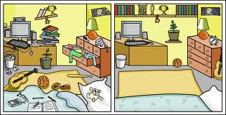
Está DESORDENADO/A
Está ORDENADO/A

Slide 7
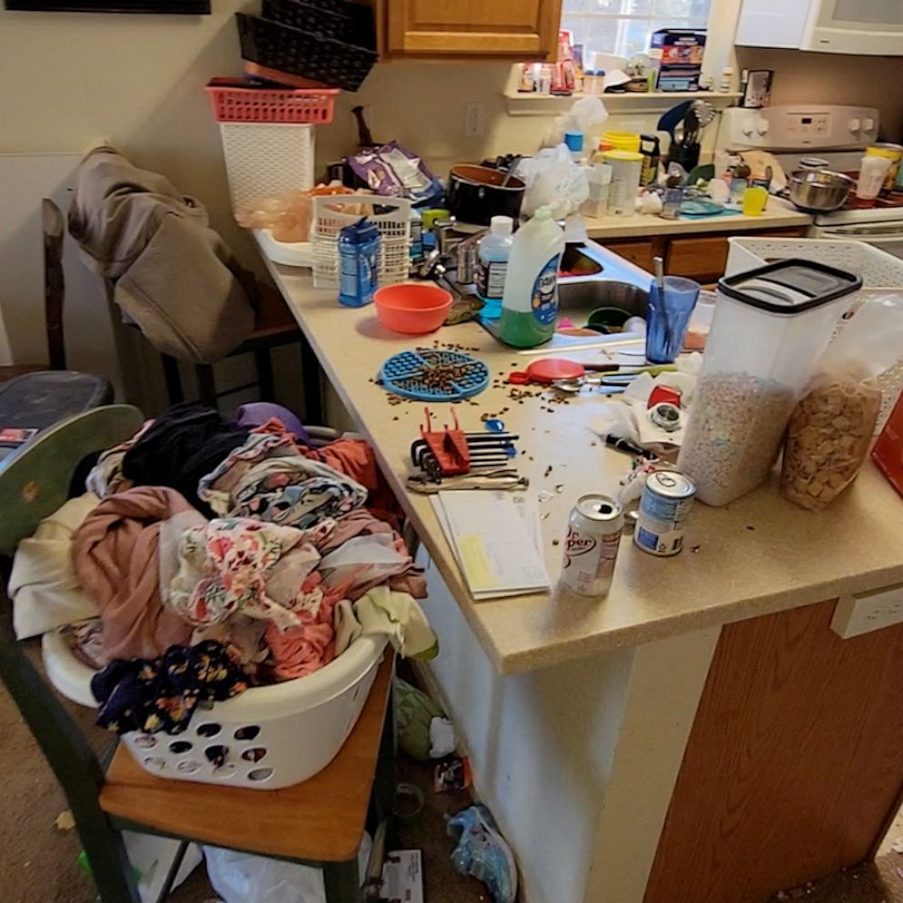
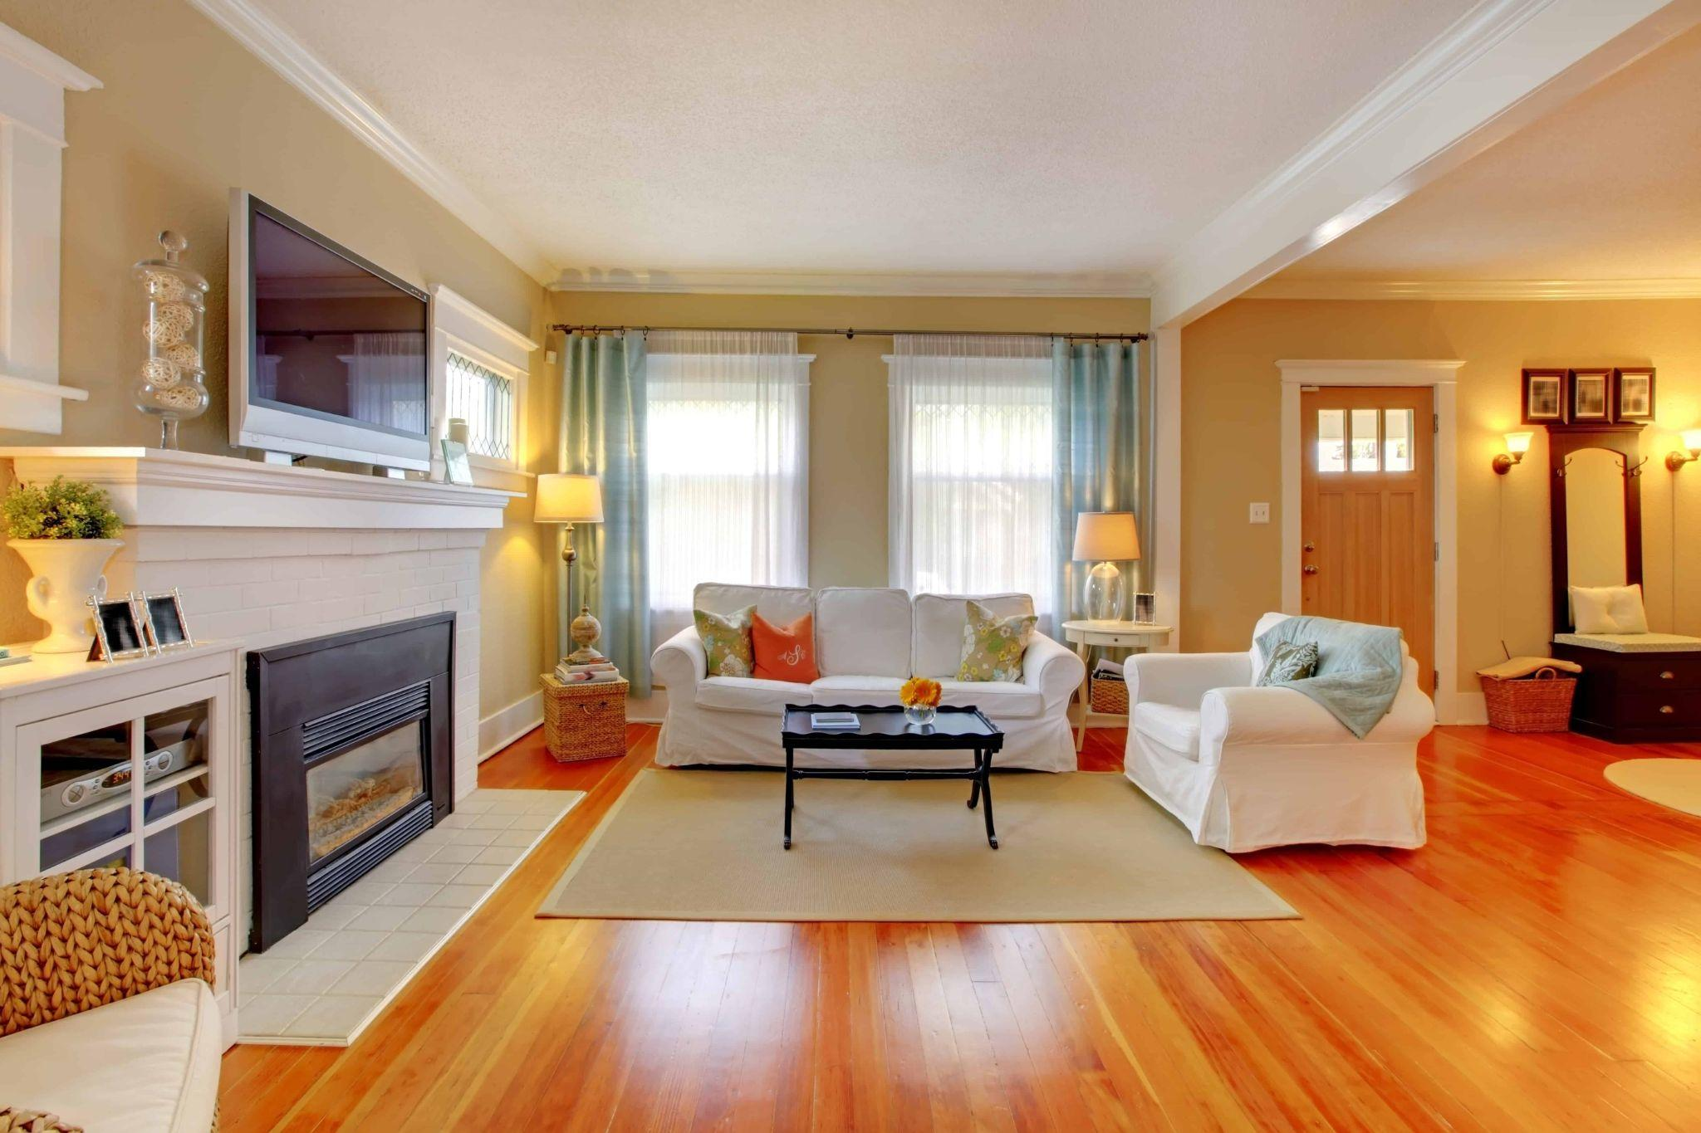
Está LIMPIO/A
Está SUCIO/A
clean
dirty

Slide 8
Here is a list of adjectives that we can use to describe a house
cómodo/a - comfortable
incómodo/a - uncomfortable
está desordenado/a – untidy
está ordenado/a - tidy
está limpio/a - clean
está sucio/a - dirty

Slide 9

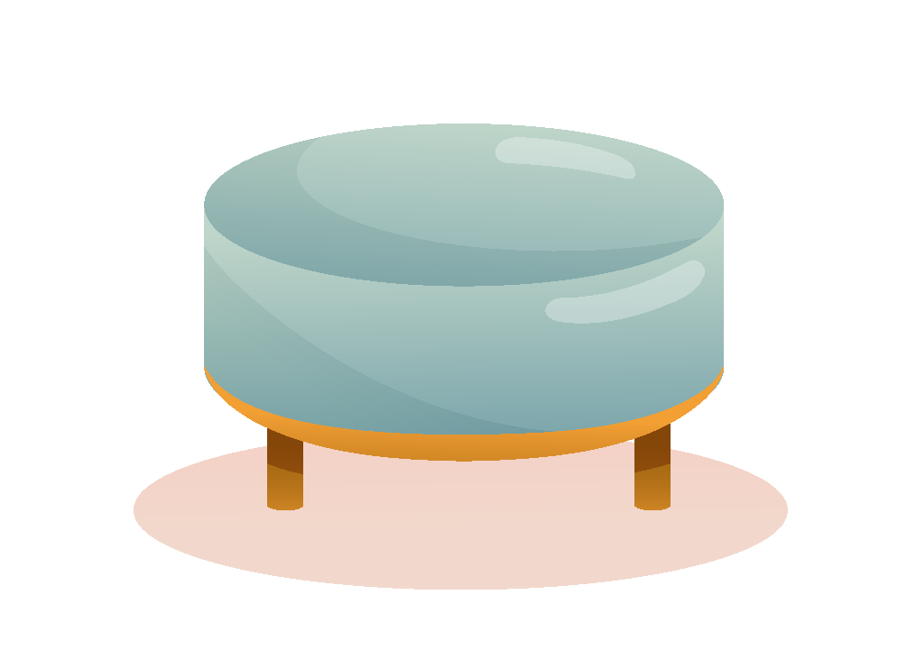
Más vocabulario
Amplio/a – spacious
Bonito/a – pretty
Enorme – enormous/huge
Grande – big
Pequeño/a - small
Moderno/a - modern
Nuevo/a – new
Viejo/a – old
Antiguo/a – ancient

Slide 10

Here is a list of adverbs that we can use to ✨enhance✨ our sentences
Muy – very
Demasiado - too
Un poco – a little
Bastante- quite
Add these right before your adjectives for a little spice ✨

Slide 11
¿Cómo son estas casas?
Write one sentence describing these houses using at least two adjectives you learned today. Remember to add some ✨enhancement✨ to your sentences.

Slide 12
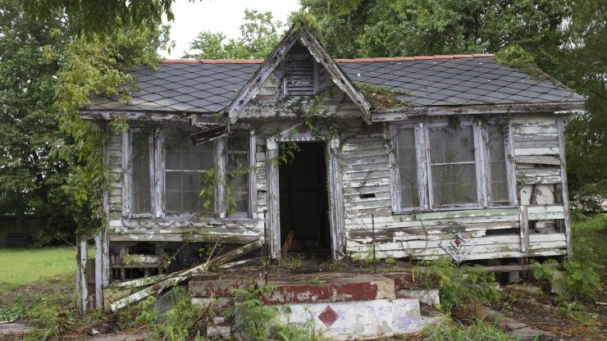

Slide 13
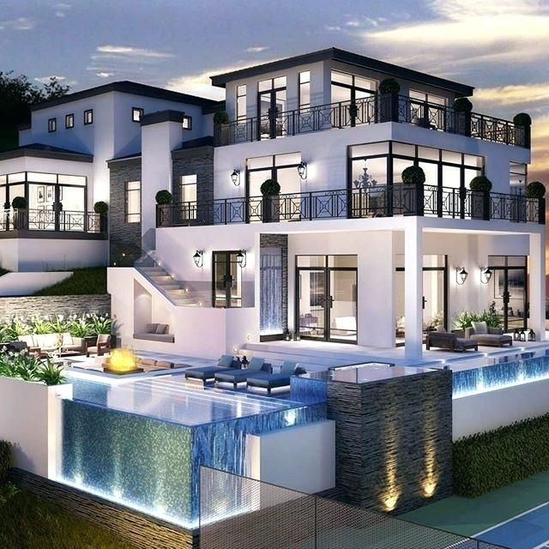

Slide 14
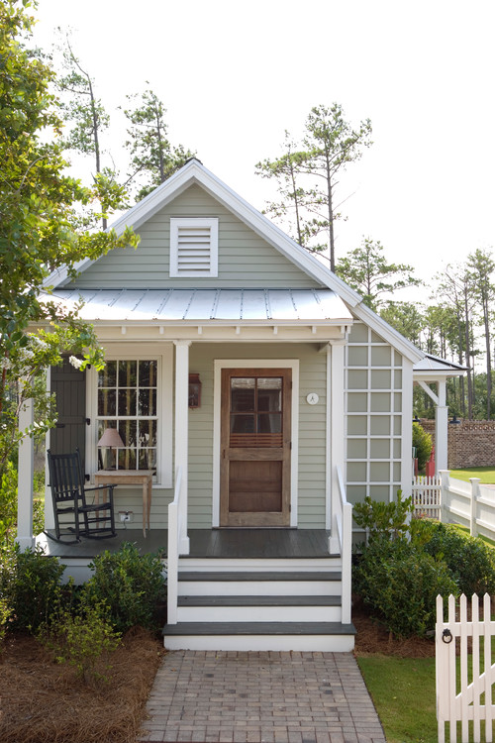

Slide 15
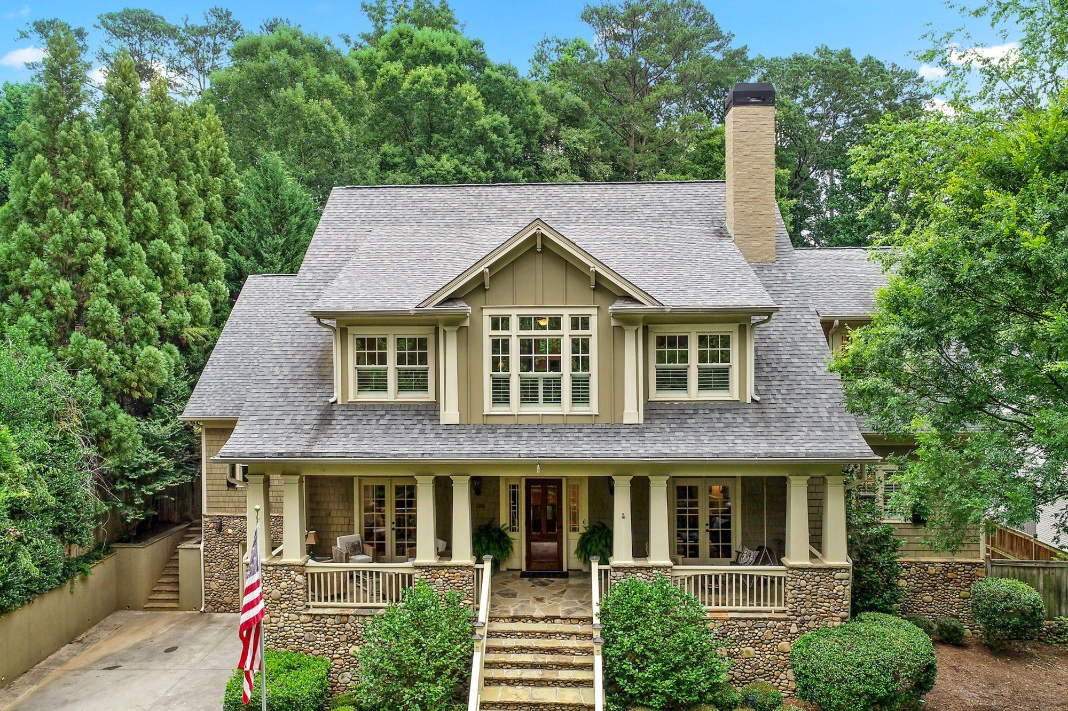

Slide 16
¿CÓMO ES TU CASA?
Grado 7°
2do sesión

Slide 17

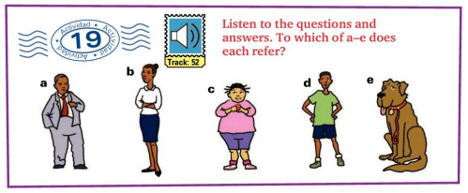
Vamos a escuchar

Slide 18
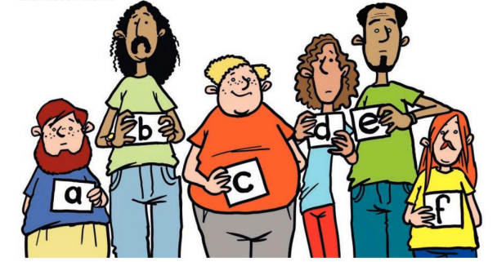
¿Quién es el ladrón?
Notes:
The teacher is to read the following sentences to help students identify the thief.
El ladrón no tiene los ojos verdes. No tiene el pelo liso. No tiene bigote. No tiene el pelo largo. No es pelirrojo. No tiene los ojos negros. No tiene barba. No tiene el pelo castaño. No es delgado.

Slide 19

¿ De qué color es tu casa?

Slide 20

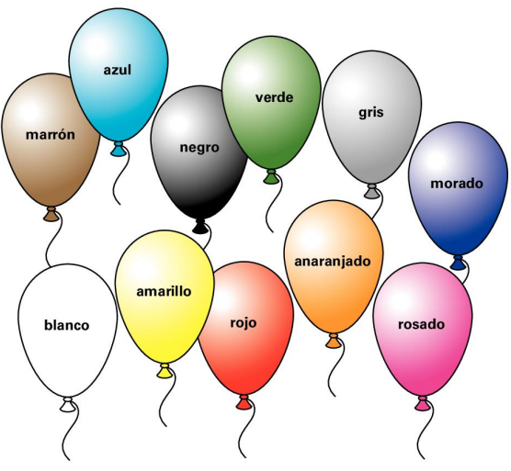

Slide 21
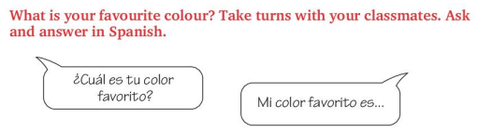

Slide 22
Los colores
Colours are adjectives and follow the same rules.
They change according to the gender of the word they are describing:
Por ej. - La casa es roja. El lápiz es rojo
When the noun they are describing is plural, they are pluralized as well.
Por ej. - Las casas son verdes. Los lápices son amarillos.

Slide 23
Graded Grammar Classwork
Please see Drive for the activity

Slide 24
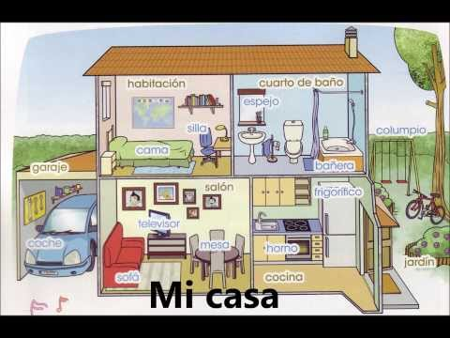

Slide 25

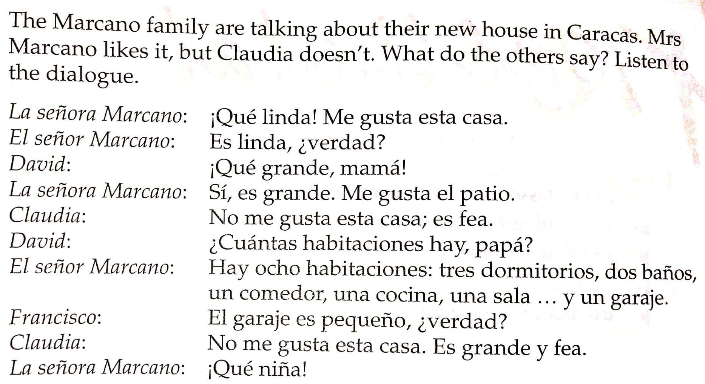
Warm - up Activity.
What do you think the phrases in the red boxes mean?
Notes:
Divide students into groups of 4 to read the following dialogue. They will switch roles. 7 mins

Slide 26
Comprehension
How does Mrs. Marcano express that she likes the house? (Write the Spanish and English phrase)
How does Claudia express that she does not like the house?(Write the Spanish and English phrase)
What does David say about the house?
What does David ask his father about the house?
What does his father reply? ( a full, complete answer)
Notes:
The students are to answer the following questions as a group, in complete sentences.

Slide 27
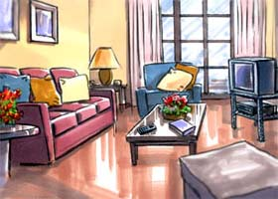
El salón/La sala

Slide 28
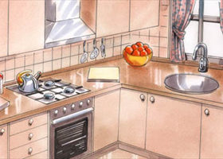
La cocina

Slide 29
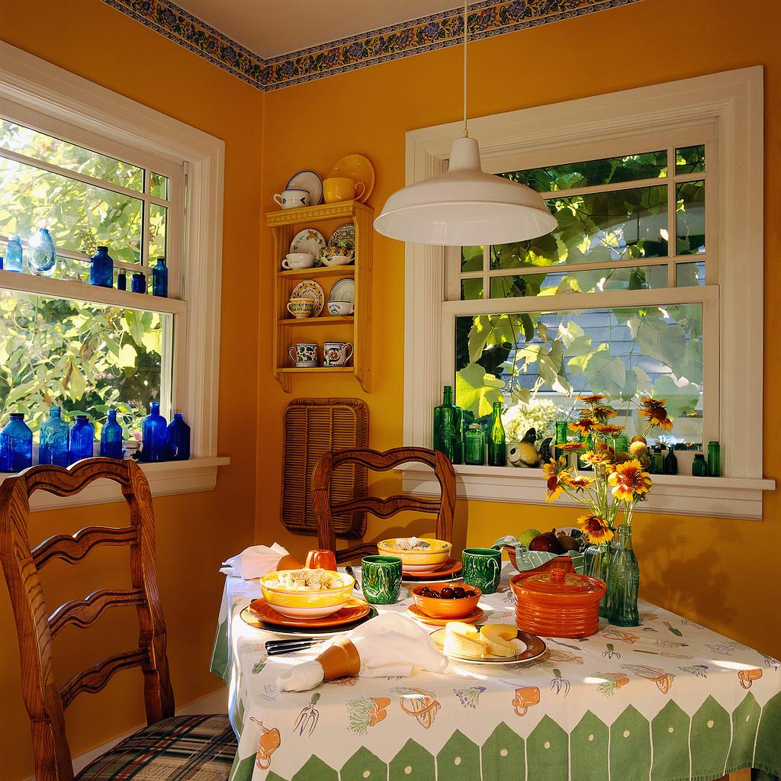
El comedor

Slide 30
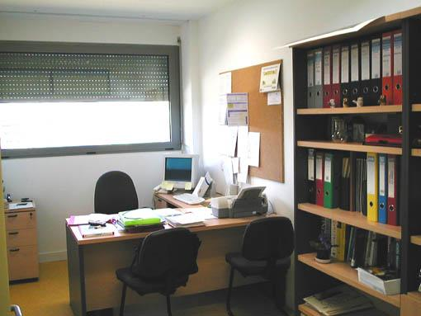
El despacho/El estudio
Notes:
office/study

Slide 31
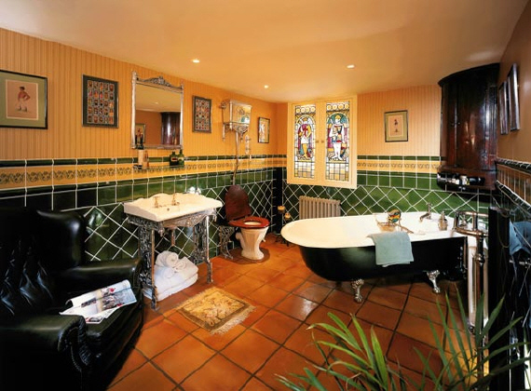
El cuarto de baño/ El baño

Slide 32
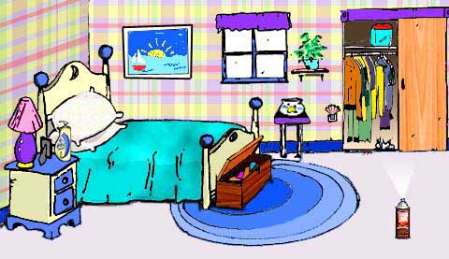
El dormitorio

Slide 33
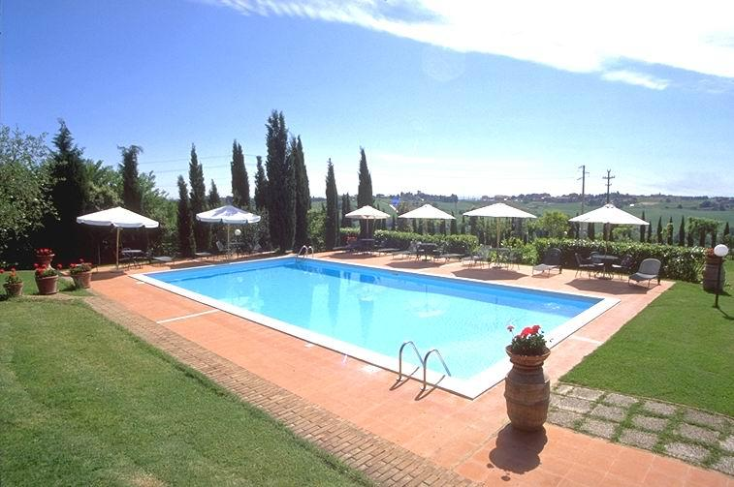
OTRAS PARTES DE LA CASA
La piscina

Slide 34
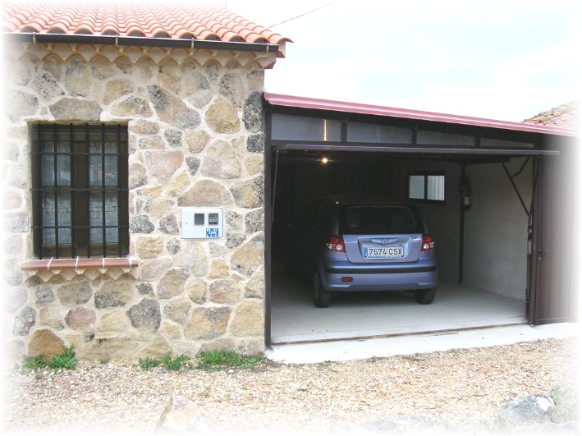
El garaje

Slide 35
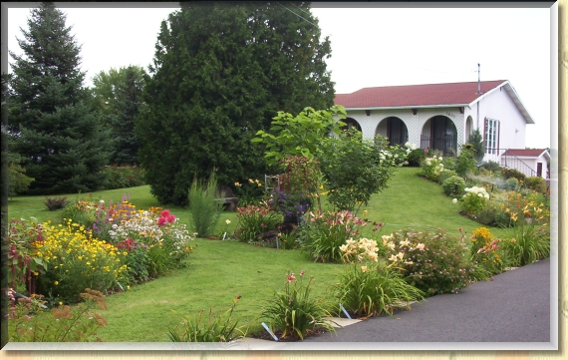
El jardín

Slide 36
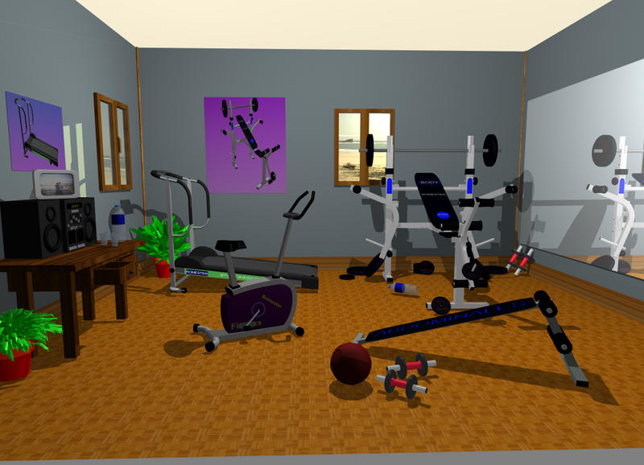
El gimnasio

Slide 37
¿ De qué color es … ?

Slide 38
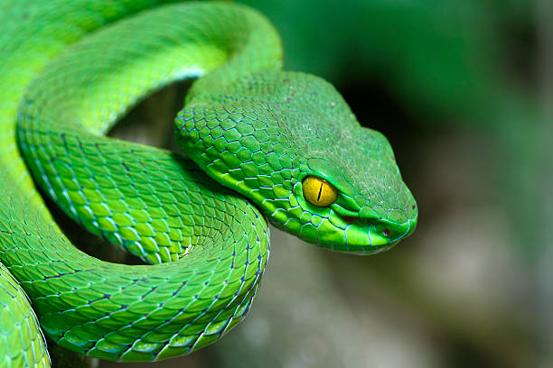
Las serpientes
Notes:
Students are to practice writing questions and answer

Slide 39
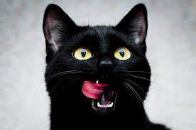
El gato

Slide 40
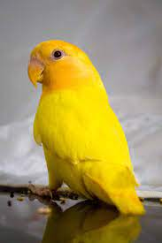
El pájaro

Slide 41
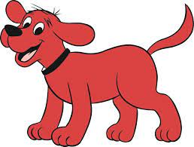
Los perros

Slide 42
Let’s revisit this dialogue
What do you think the phrases in the red boxes mean?
Notes:
Divide students into groups of 4 to read the following dialogue. They will switch roles. 7 mins

Slide 43
Me gusta/No me gusta
Me gusta - I like it
When a singular thing or person pleases me, I say me gusta.
Me gusta la casa - I like the house
Me gusta. - I like it
No me gusta la casa - I don’t like the house
No me gusta. - I don’t like it

Slide 44
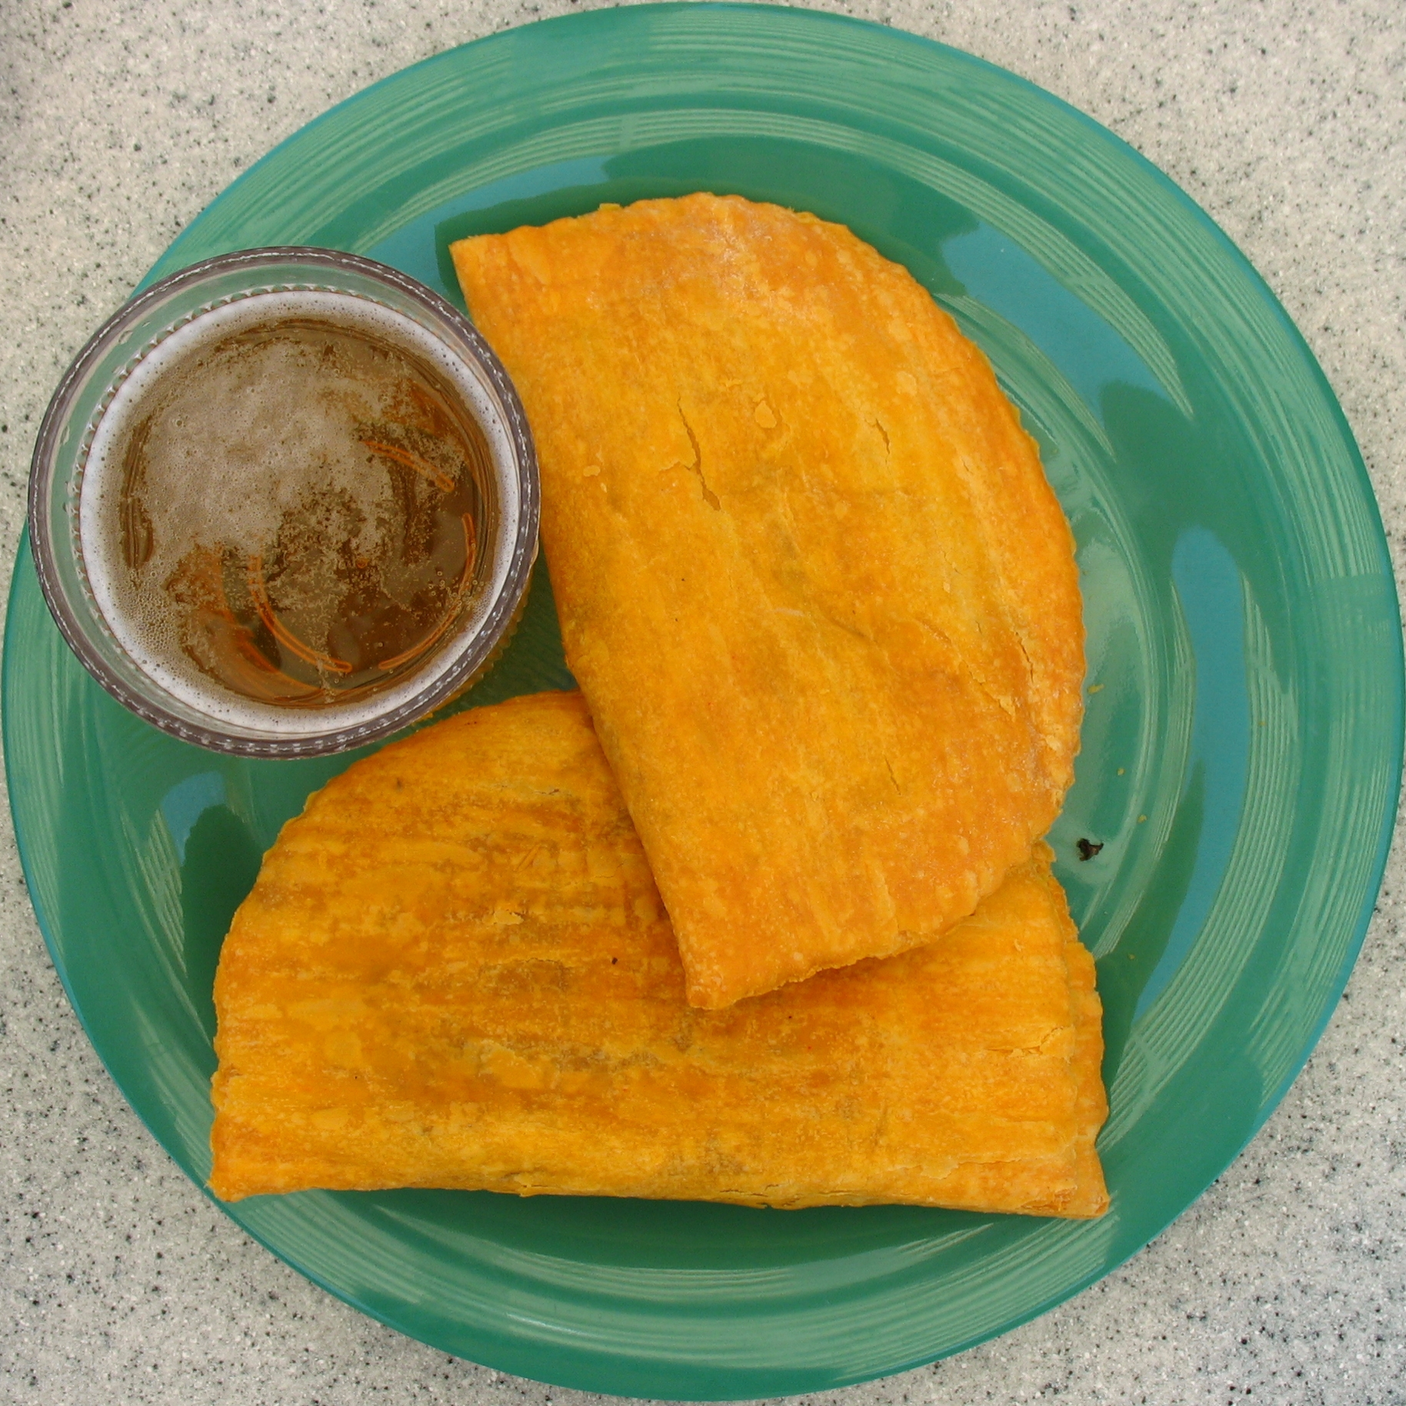
Me gusta/No me gusta
Vamos a conversar
Notes:
The students are to answer the following questions as a group, in complete sentences.

Slide 45
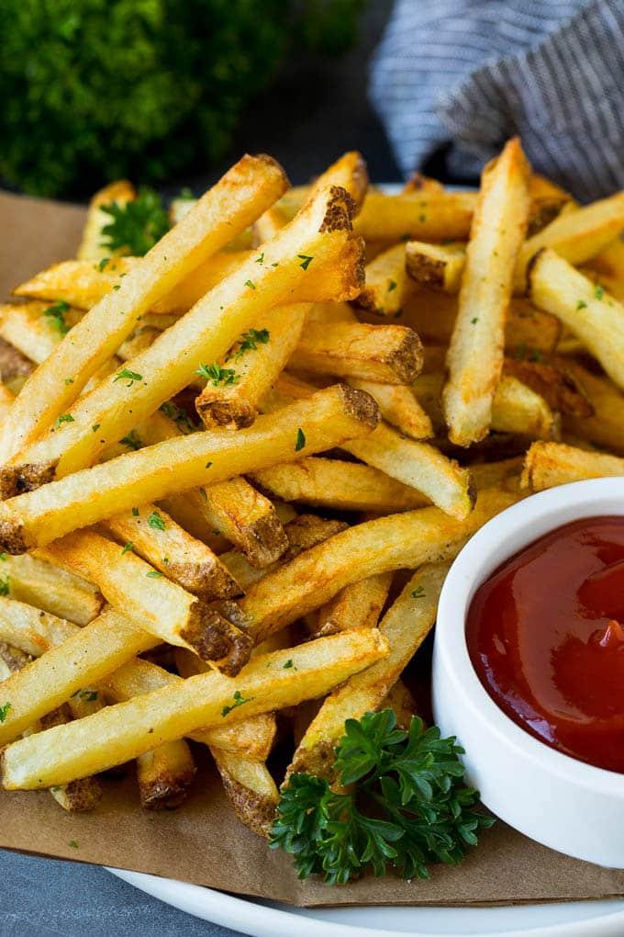
Me gusta/No me gusta
Notes:
The students are to answer the following questions as a group, in complete sentences.

Slide 46
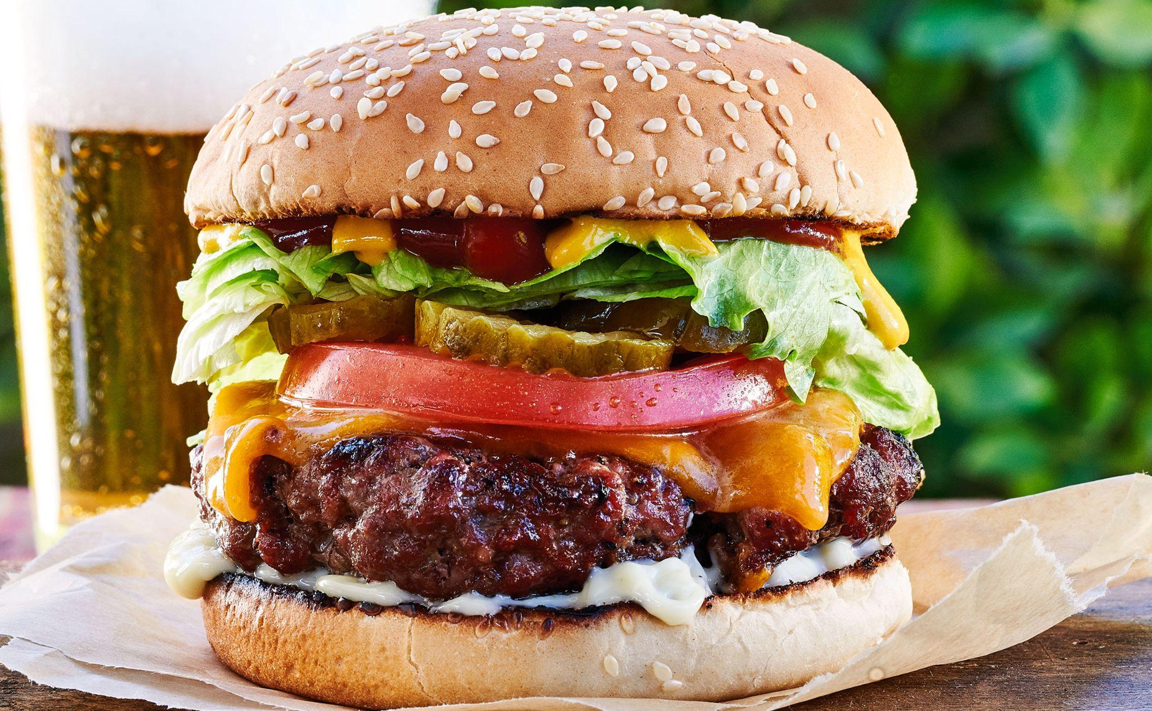
Me gusta/No me gusta
Notes:
The students are to answer the following questions as a group, in complete sentences.

Slide 47
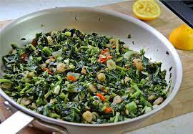
Me gusta/No me gusta
Notes:
The students are to answer the following questions as a group, in complete sentences.

Slide 48
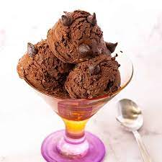
Me gusta/No me gusta
Notes:
The students are to answer the following questions as a group, in complete sentences.

Slide 49
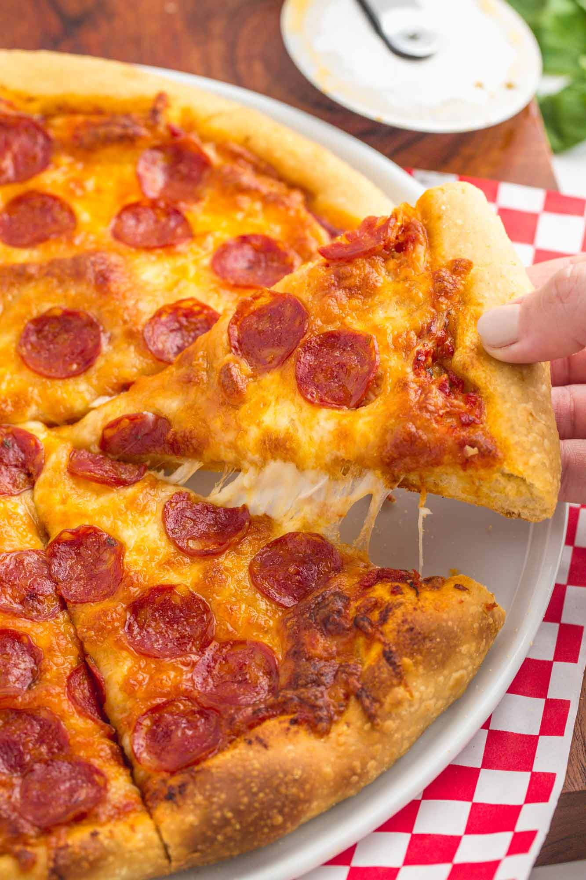
Me gusta/No me gusta
Notes:
The students are to answer the following questions as a group, in complete sentences.

Slide 50
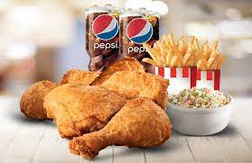
Me gusta/No me gusta
Notes:
The students are to answer the following questions as a group, in complete sentences.

Slide 51
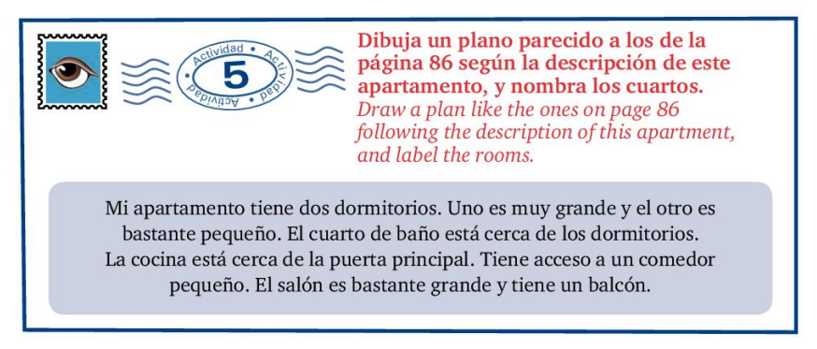
Let’s translate en parejas

Slide 52
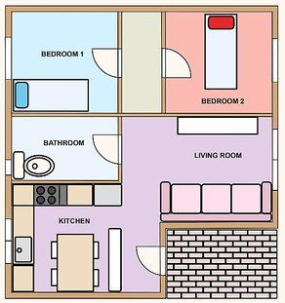
¿Cuántas habitaciones hay?

Slide 53
Do you remember what David asked his father about the house in the dialogue?
How do we know if we are to use Cuántos or Cuántas ?
Examine these examples:
¿Cuántas habitaciones hay?
¿Cuántos baños hay?
What do you observe?

Slide 54
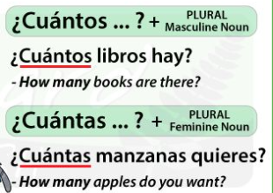

Slide 55

Vamos a Practicar: Write Cuántos or Cuántas before the following nouns
Casas
Dormitorios
Salones
Habitaciones
Garajes
Cuartos de baño
Comedores

Slide 56

Let’s practice asking about the different rooms in the house:
¿Hay --------------- en tu casa?
¿Cuántos/ Cuántas ------------------ hay en tu casa?
Ejemplo:
¿Hay una cocina en tu casa?
¿Cuántas cocinas hay?

Slide 57
Match the English vocabulary in Column A with the Spanish equivalent in Column B
COLUMN A
___Pool
___Dining room
___ Living room
___ There is/are
___Level(floor)
___Kitchen
___Home
___Basement
COLUMN B
El Sótano
Hay
La Sala
La Piscina
El Piso
La Cocina
El Comedor
El hogar
La Casa

Slide 58
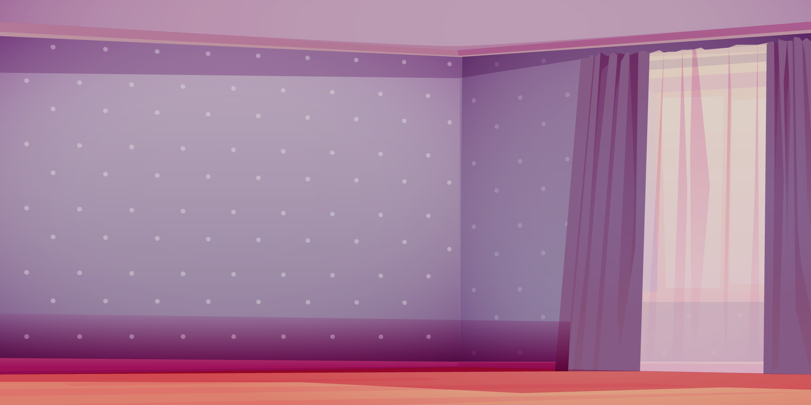



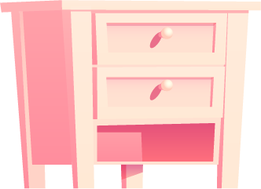
¿Qué hay en tu
dormitorio?
7° grado

Slide 59
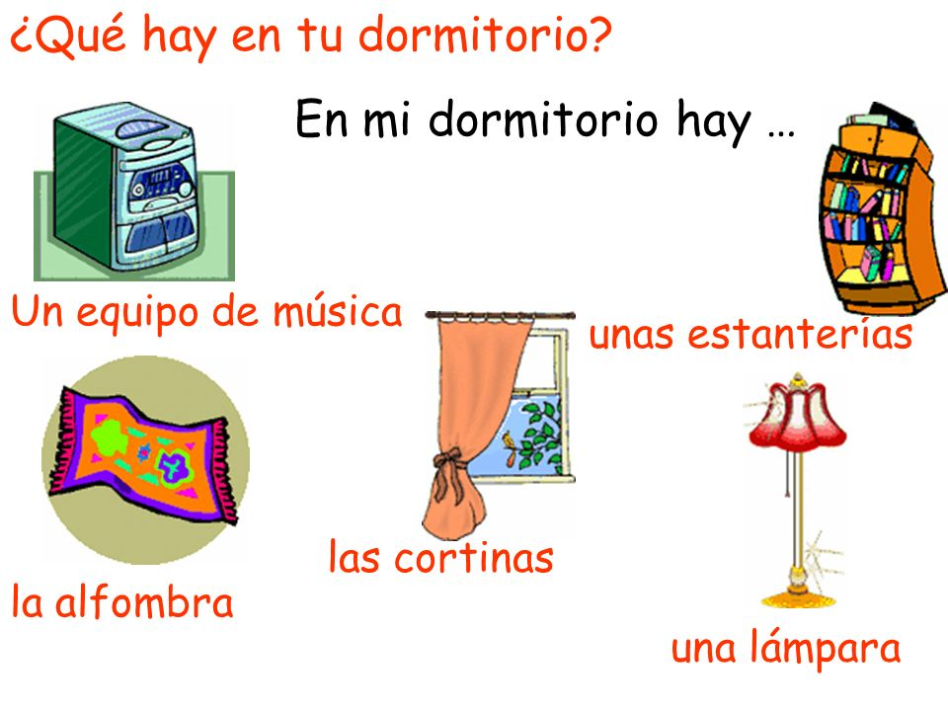

Slide 60
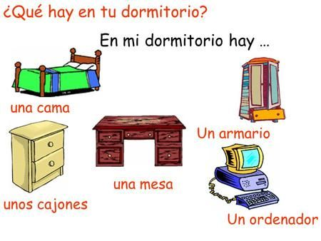

Slide 61
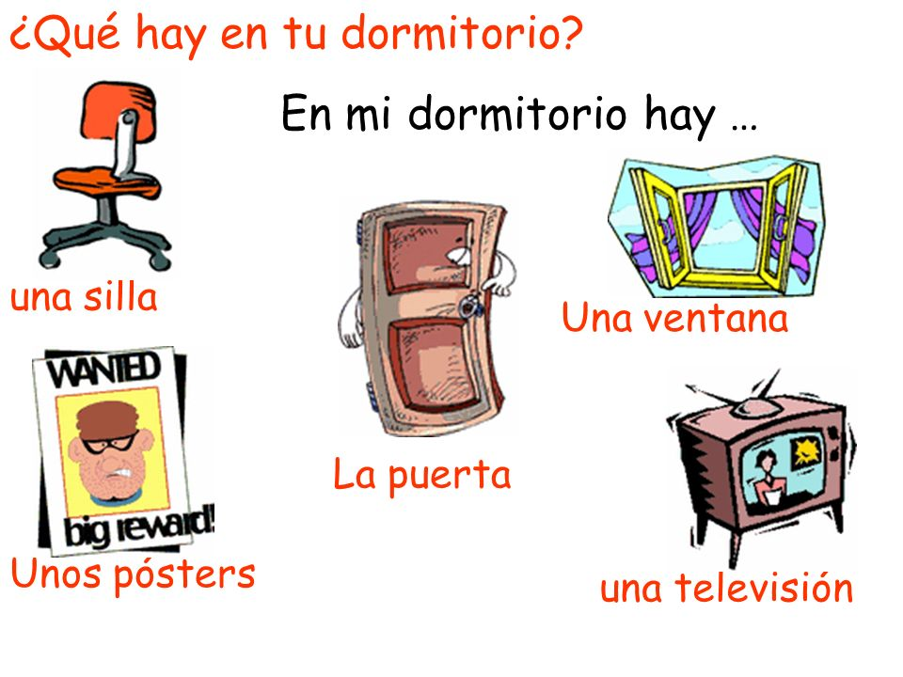
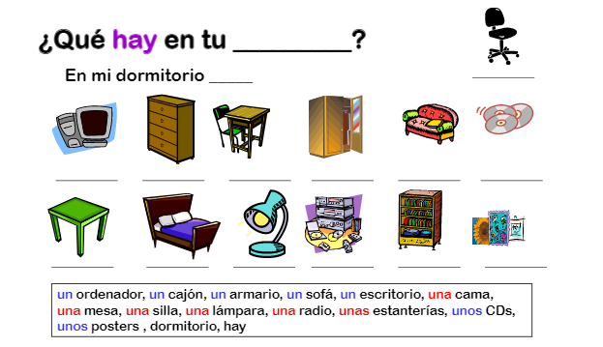
una mesa

Slide 62
Quick fingers…. Can you label all these items ? Be the first to volunteer by raising your hand.

Slide 63
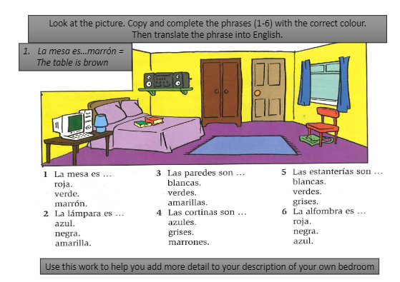


Slide 64

Mi Dormitorio
Graded writing activity to be submitted at the end of the class.

Slide 65
Write out a detailed description of your room at home using the following questions as a guide.
¿Cómo es tu dormitorio? Mi dormitorio es… (2mks)
¿Qué hay en tu dormitorio? En mi dormitorio, hay…No hay… (3mks)
¿De qué color es tu dormitorio? Mi dormitorio es… (2mks)
¿Te gusta tu dormitorio? ¿Por qué/ no? Me gusta mi dormitorio porque es…/No me gusta mi dormitorio porque es… (2mks)

Slide 66


